Slide 1
procedure | difinition | indications | contraindications | technique
Gingectomy | Excision of the gingiva | Elimination of suprabony pockets regardless it’s depth when it’s firm or fibrous Elimination of gingival enlargement Elemination of suprabony periodantal abcesses | The need for bone surgery Bottom of the pocket is apical to mucogingival junction Esthetic consideration (anterior maxilla) | Pocket exploration -pocket Marking (outline the course) - buccal and lingual incision using kirkland knife Interdental incision using orban knife Incision should be beveled 45 degrees with tooth surface Incision should be startedapical to point marking coronally to a point between the base of pocket and crest of bone Remove the pocket, clean and curatte the area Cover with surgical pack
Gingivoplasty | Reshaping the gingiva to create physiologic gingival contour with sole purpose of recontouring in absence of pockets | Gingival & periodonta; diseases: 1. gingival clefts and craters 2. crater-like interdental papillae | ------ | Accomplished by periodontal knife, scalple,rotary course diamond stones or electrodes Consists of : 1. tapering the gingival margin 2. creating a scallooped marginal outline 3. thinning attached gingiva 4. shaping interdental papllae

Slide 2
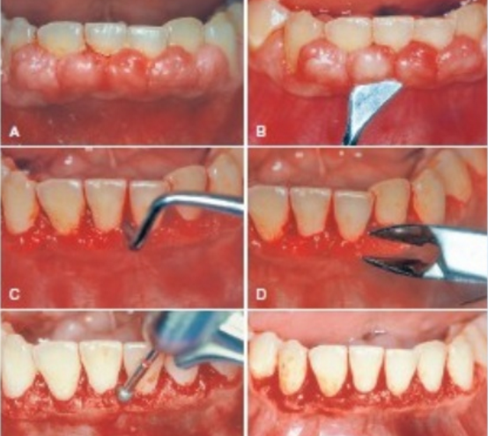
Surgical gingivectomy

Slide 3
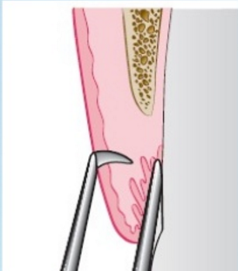
Pocket marker

Slide 4
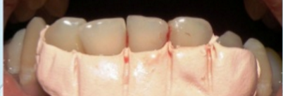
Surgical pack

Slide 5
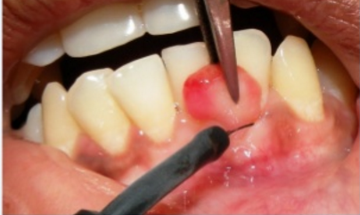
Gingivectomy by electrosurgey

Slide 6
periodontal knives

Slide 7
Interrupted incision
continuous incision

