Slide 2
Full thickness mucoperiosteal flap
Split thickness flap/ mucosal flap

Slide 13
Using surgical blade #15

Slide 15
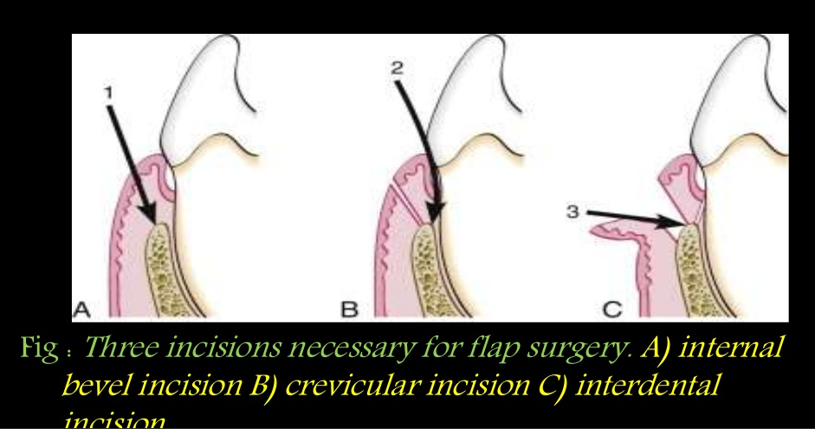

Slide 17
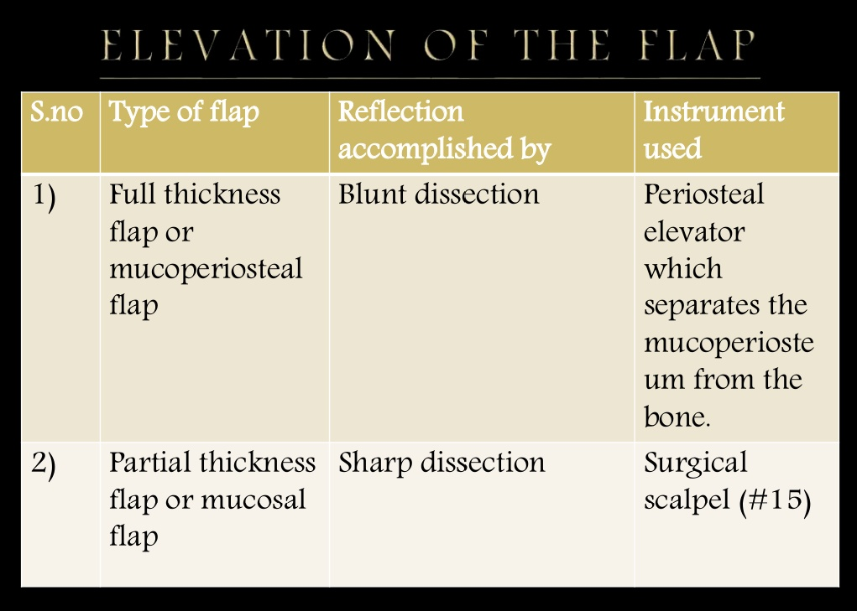

Slide 19
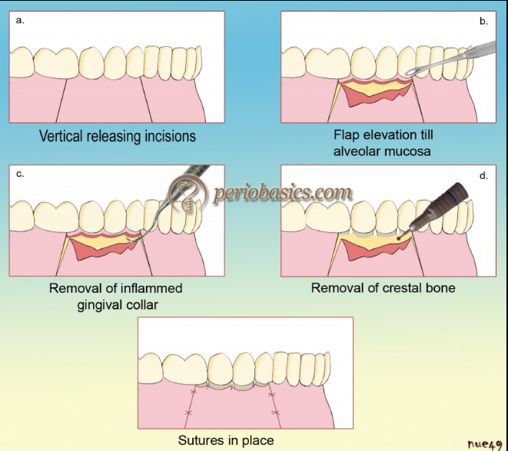
Original widman flap

Slide 20
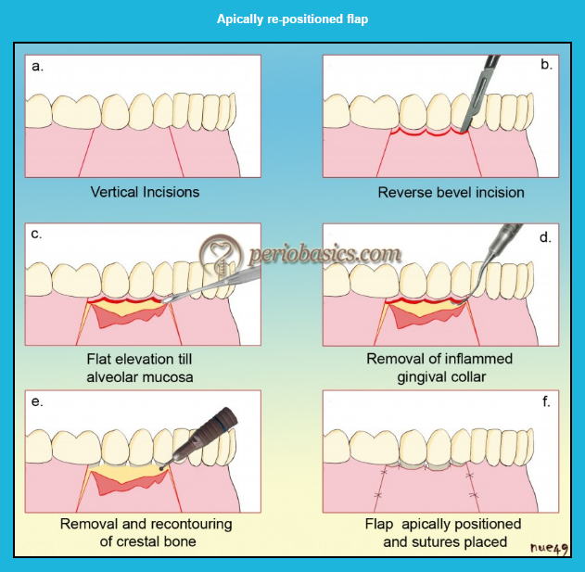

Slide 21
